Slide 1

Object-oriented Programming with Ruby
Robert Batzinger
CSCI A-201
Spring 2009

Slide 2
Class components:
Implementing attributes and methods from a design

Slide 3
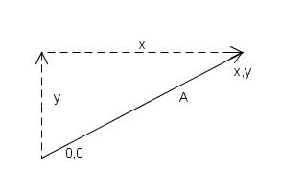
Vector class
Individual vectors are object of this class
Requires x and y values
Basis on which we could create operators to work with vectors

Slide 4
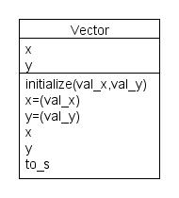
Vector class
Methods Examples
Model
Constructor
v = Vector.new(1,2)
Setter Methods
v.x = 5
v.y = 10
Accessor Methods
x = v.x
y = v.y
Display/Format Method
puts v

Slide 5
Constructor Methods
Used to establish an instance of a class
Sets up memory storage for the object
Can be used to call parent constructor methods
Initialize the values of attributes
Assigning values to attributes
Establish the data types of the attributes
v1 = Vector.new(5,1)
v2 = Vector.new(1,1)
v3 = Vector.new(1,5)
v4 = Vector.new(0,0)

Slide 6
Method Parameters
Provides values to a method
Setting a default value is possible
Possible to define multiple operators
def x(x_value)
@x = x_value
end
def x(x_value=0)
@x = x_value
end

Slide 7
Setting/changing of attribute values
Allows a new value to be assigned to the instance variables
Can redefine the assignment operator as a method
def x(x_value)
@x = x_value
end
def x=(x_value)
@x = x_value
end

Slide 8
Accessor Methods: Querying the values
Methods return the last value referenced
Value can be the result of an expression
def x
@x
end
def double_x
@x + @x
end

Slide 9
Long Hand Technique
Explicit declaration of all methods common to most object-oriented languages
Class Vector
# Constructor
def initialize(x,y)
@x = x
@y = y
end
# Display Format
def to_s
“(#{@x}, #{@y})”
end

Slide 10
Long Hand Technique (2)
# Accessor Functions
def x
@x
end
def y
@y
end
# Setter Functions
def x=(value)
@x = value
end
def y=(value)
@y = value
end
end

Slide 11
Putting it all together
class Vector
# Constructor
def initialize(x,y)
@x = x
@y = y
end
# Display Format
def to_s
“(#{@x}, #{@y})”
end
# Accessor Functions
def x
@x
end
def y
@y
end
# Setter Functions
def x=(value)
@x = value
end
def y=(value)
@y = value
end
end

Slide 12
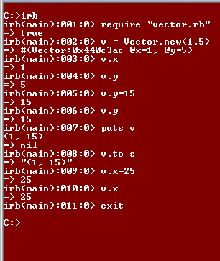
Testing a Class Definition
Place the class definition in a file
Open the interactive mode of Ruby
Read in the file
Create an object
Test out the methods using the object
Examine the object to ensure correctness

Slide 13
Ruby Shortcut Methods
class Vector
attr_accessor :x, :y
def initialize(x,y)
@x = x
@y = y
end
def to_s
”(#{@x}, #{@y})”
end
end
Instance variable declared using symbols
Accessor and setter methods are automatically created
Delivers same functionality with less work
attr_reader and attr_writer methods are available if only accessor or setter methods are required

Slide 14
Comparing to the Model
class Vector
attr_accessor :x, :y
def initialize(x,y)
@x = x
@y = y
end
def to_s
”(#{@x}, #{@y})”
end
end

Slide 15
Shortcut vs Long-Hand
class Vector
def initialize(x,y) # Constructor
@x = x; @y = y
end
def to_s # Display Format
“(#{@x}, #{@y})”
end
def x=(value) # Setter Functions
@x = value
end
def y=(value)
@y = value
end
def x # Accessor Functions
@x
end
def y
@y
end
end
class Vector
attr_accessor :x, :y
def initialize(x,y)
@x = x
@y = y
end
def to_s
”(#{@x}, #{@y})”
end
end

Slide 16
Predicate Methods
Inquires about a particular state
Returns a true or false answer
Usually has a ? At the end of the name
Can be the result of an expression or mere return a constant
def unit_vector?
dist = @x * @x
dist += @y * @y
dist == 1
end
def vector?
true
end

Slide 17
End of lecture

